Slide 1
GOLD CHALLENGE
Hate Speech in Social Media: A Study on Tweet Sentiment
DAVINCA RIZQY ADINDA ISMAIL DATA SCIENCE 5
Email : davincarizqy78@gmail.com
Github : https://github.com/Davinca23

Slide 2
Table of contents
02
01
03
Preliminary
Research Methods
Result & Conclusion

Slide 3
01
Preliminary
BACKGROUND, PROBLEM STATEMENT, RESEARCH GOAL

Slide 4
Preliminary
The background of this report is about hate speech in tweets in the digital era. Hate speech is a statement of hatred that can be dangerous and harmful to individuals or specific groups and can easily be spread through social media such as Twitter. Therefore, it is important to understand and analyze the level of hate speech in tweets.
The problem statements in this report are exploring the tweet length, sentiment, and hate speech in social media, evaluating the effectiveness of censorship techniques to analyze the bad words we censored from social media easily, identifying the most common topics discussed in social media and their association with hate speech, & examining the relationship between sentiment and total word count in tweets, with a focus on the impact of hate speech.
The goal of this report is to analyze hate speech tweets data and find the level of hate speech and the factors that affect it. The results of this analysis are expected to provide important insights for relevant parties in addressing the problem of hate speech.

Slide 5
01
Data Description
The data for this research is sourced from Kaggle, which has been published in the following link. More specifically, the data being analyzed is a collection of comments in the Indonesian language obtained from the social media platform Twitter in 2019. We use 12942 data. It has three labels to categorize each cleaned tweet, which are “Negative Toxic“, “Positive“, and “Neutral”. To determine the tweets be labeled as “Positive”, we use Positive_words.txt that contains list of positive words.
02
Data analysis method
The analysis method used in this research is using Descriptive Analytics, because it aims to describe patterns in the data. This type of analysis is considered appropriate because it focuses on finding out the condition of data and studying the patterns of data.
03
Statistics method & Visualization
The analysis is processed based on the columns processed, which is 1 variable (Univariate Analysis). In each process, it applies the Descriptive Statistics and Visualization methods. Descriptive statistics are used to find out the distribution of data in numbers, while visualization is used to find out the distribution of data visually.

Slide 6
02
Research Methods

Slide 7

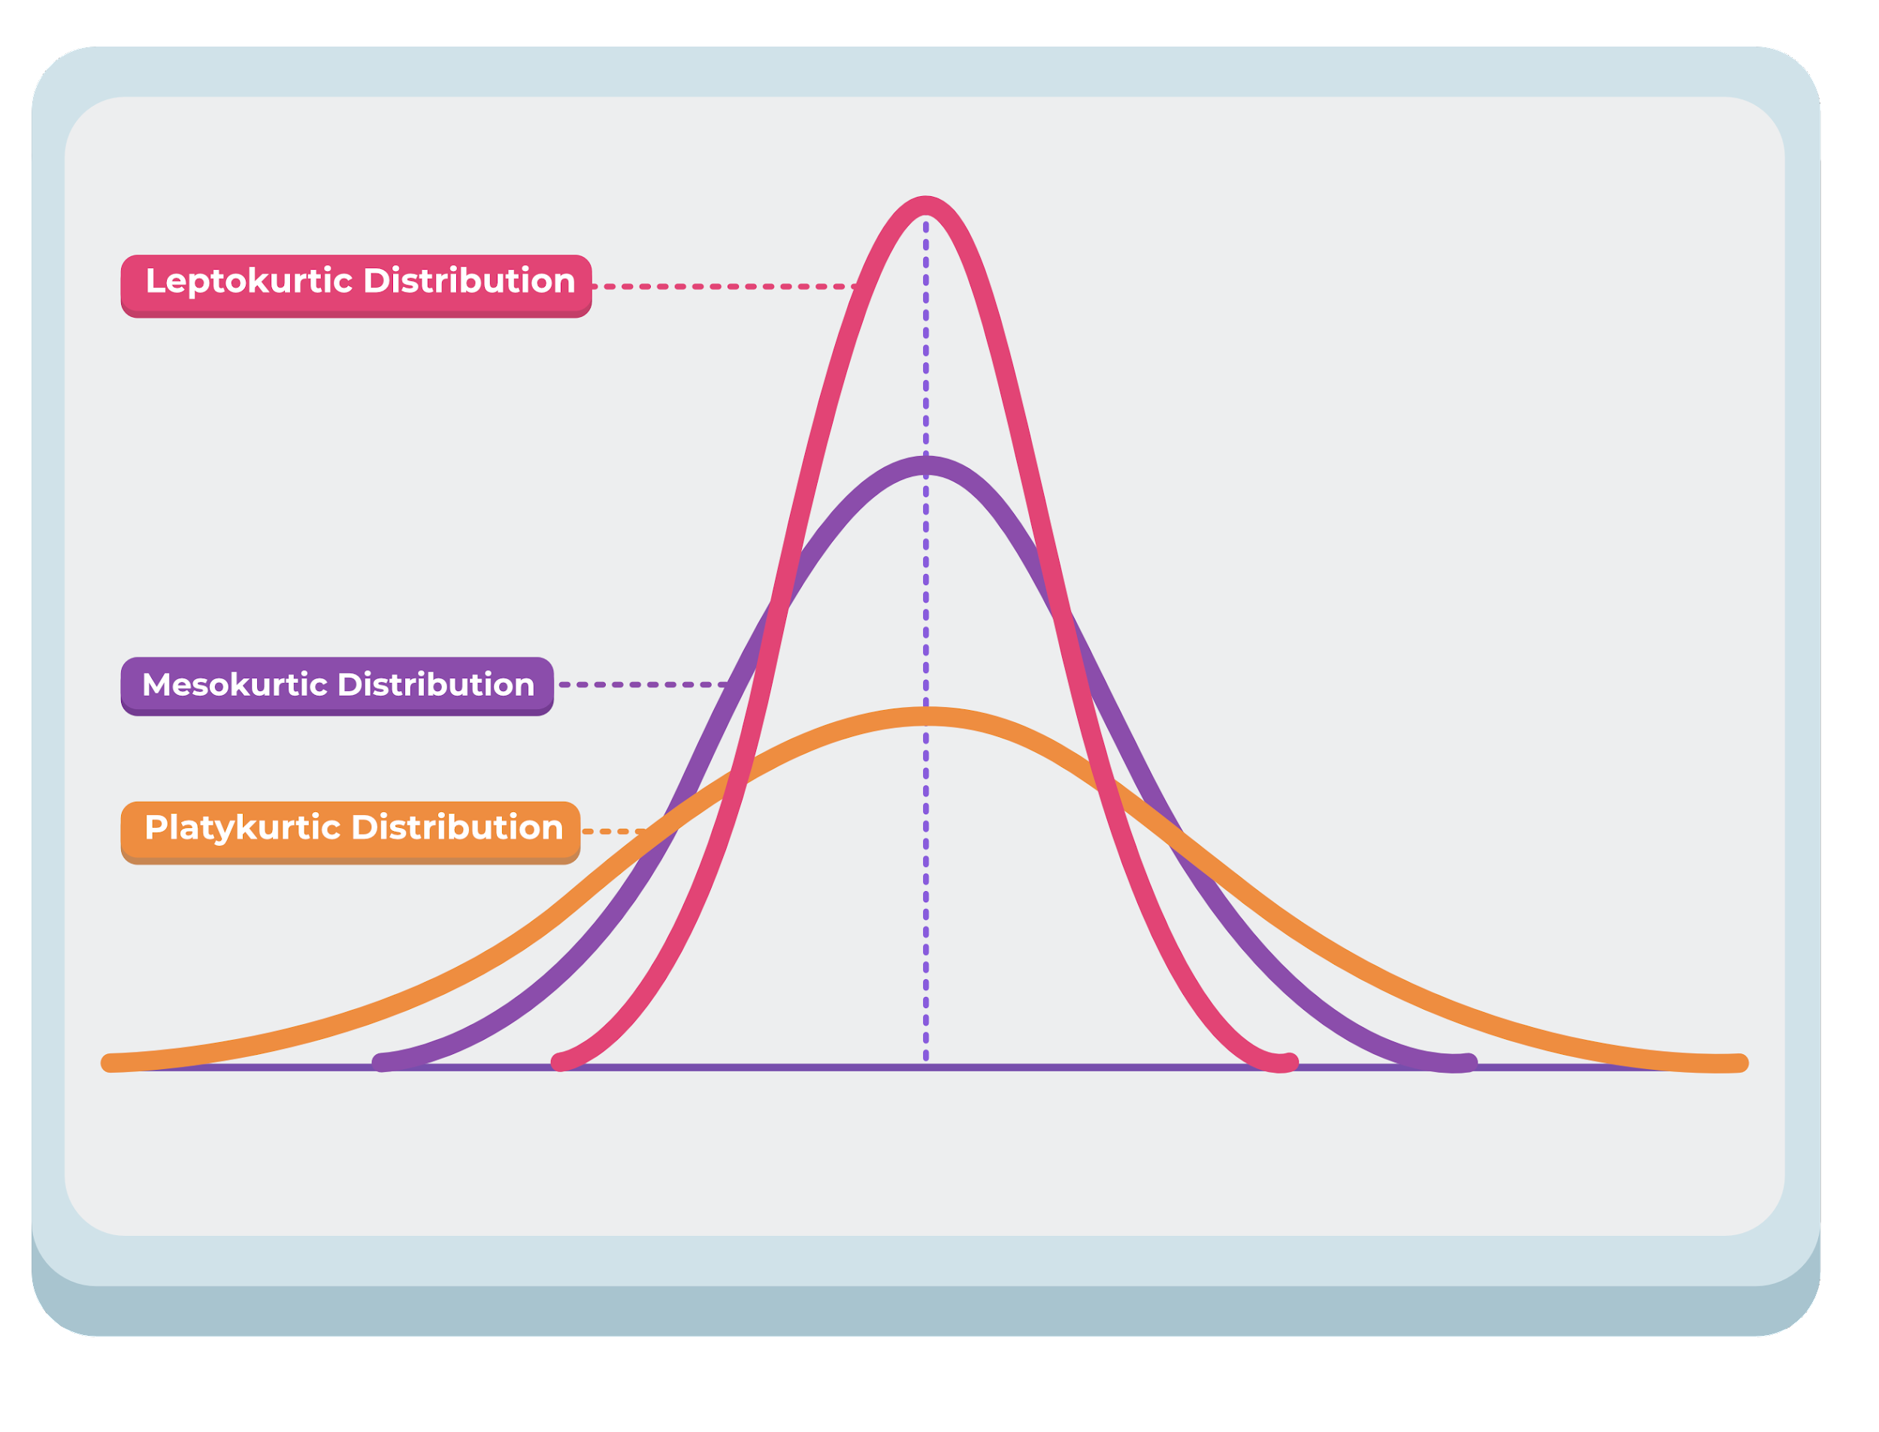
In Descriptive Statistics, it shows that the data we processed has outliers but not too significant, because The kurtosis value possessed is below 3 (Platykurtic Distribution).

Slide 8
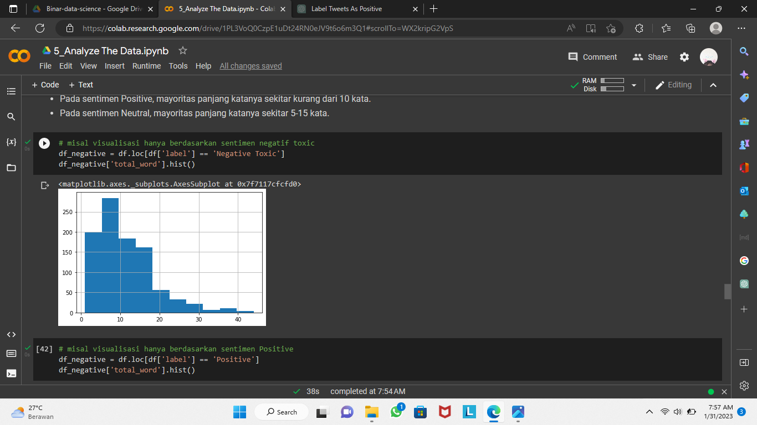
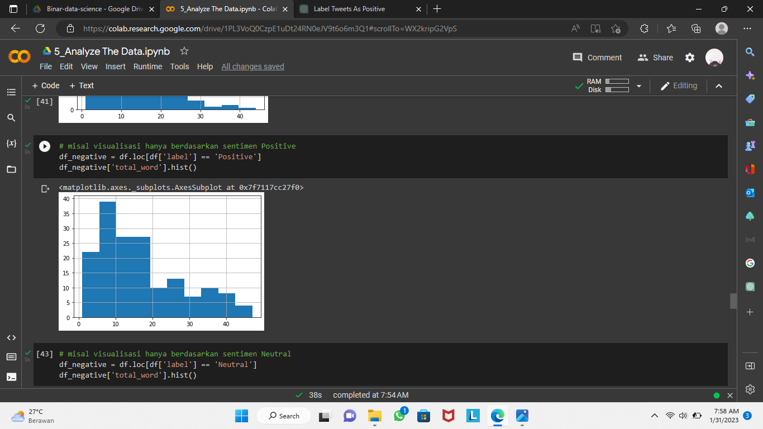
In the visualization it shows:
In the graph for the "Negative Toxic" sentiment, it is seen the graph is positive skewness graphs which means that most tweets in the "Negative Toxic” has fewer words compared to tweets in each respective category that have more words.
For the “Positive" sentiment, the majority of the tweets in the "Positive" label have a similar number of words and that there are few tweets with either significantly fewer or significantly more words.
NEGATIVE TOXIC
POSITIVE

Slide 9
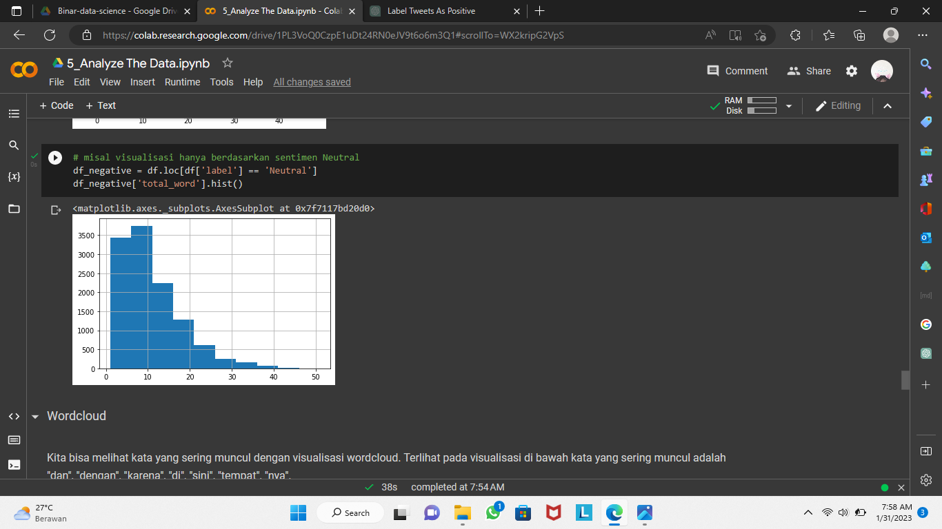
In the visualization it shows:
In the graph for the “Neutral" sentiment, it is seen the graph is positive skewness graphs which means that most tweets in the " Neutral” has fewer words compared to tweets in each respective category that have more words.
NEUTRAL

Slide 10
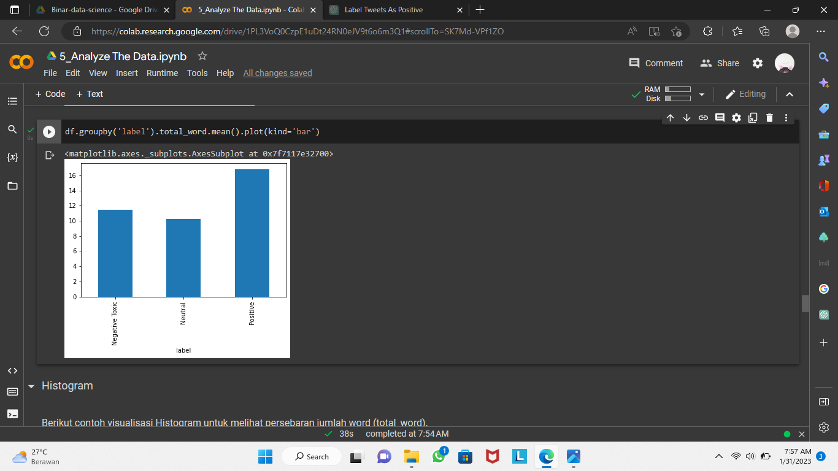
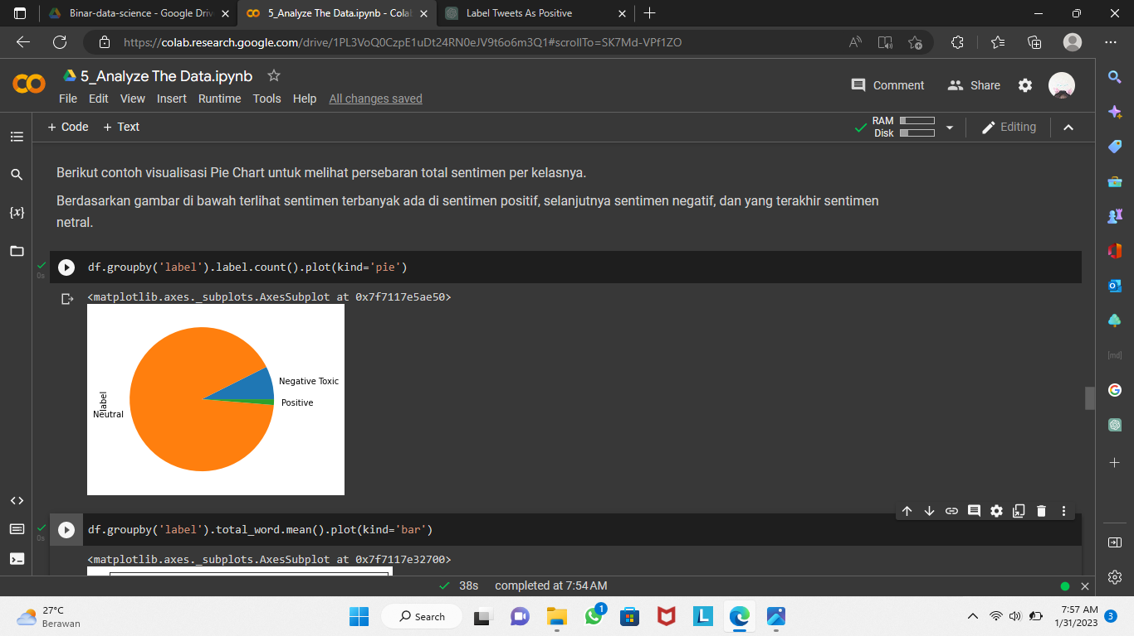
The majority of tweets are held by Neutral sentiment, followed by Negative Toxic sentiment, and lastly Positive sentiment.
The highest average in total words is held by the Positive sentiment, followed by the Negative Toxic sentiment and lastly the Neutral sentiment.
b.
a.

Slide 11
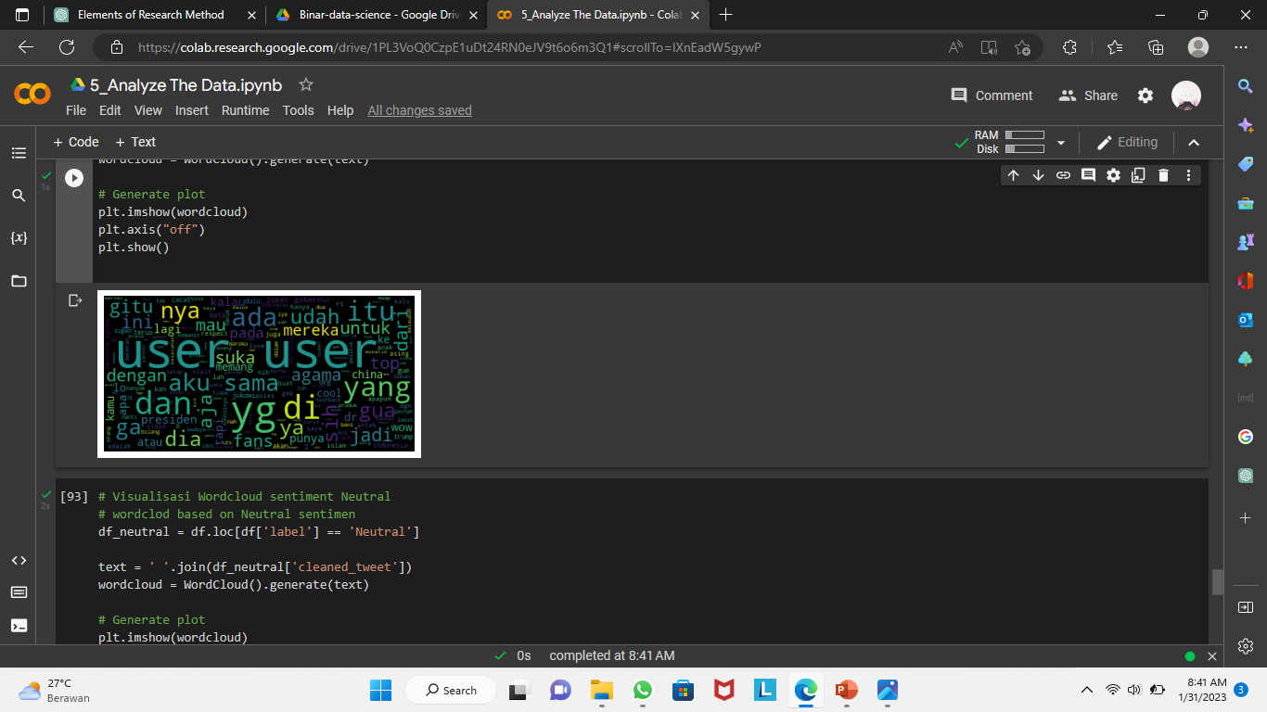
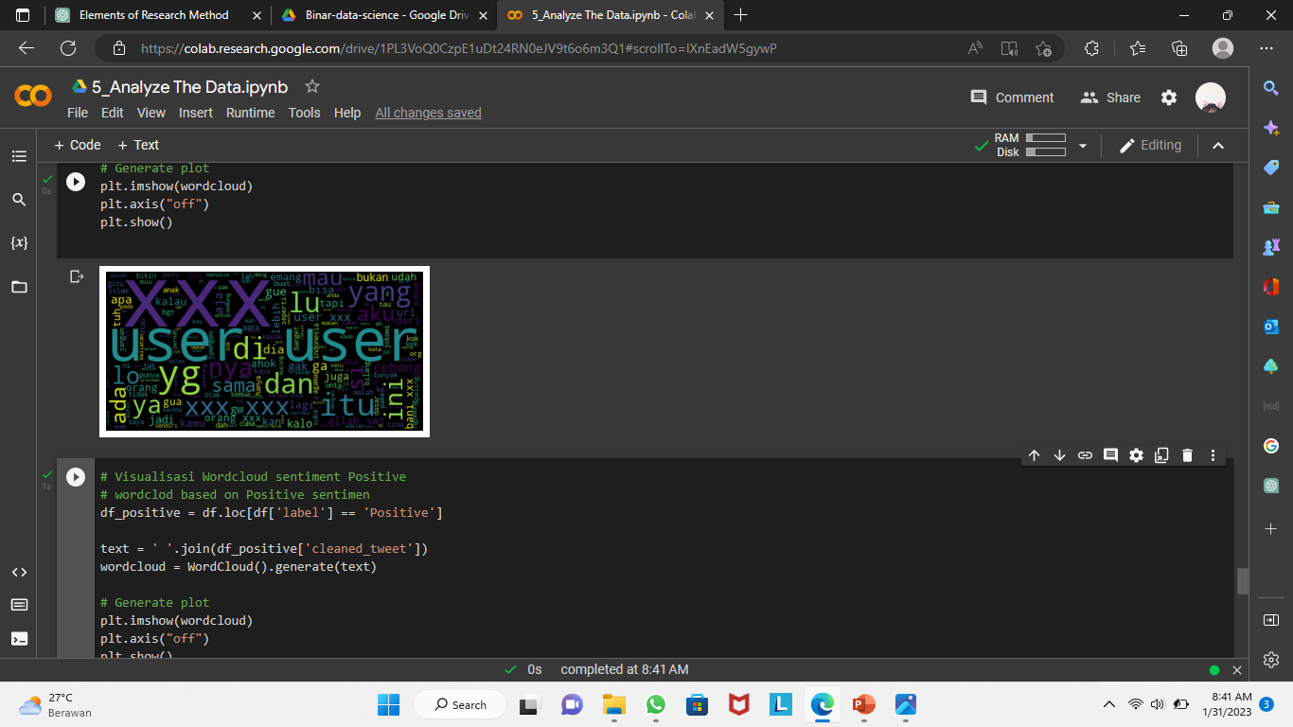
In the "Negative Toxic" sentiment, the words that often appear are "xxx" which is a censoring word used for censoring vulgar words during the data cleaning process.
The sentiment “Positive" does not have the word "xxx“. This means that the tweets' labeling is accurate that the “Positive" category does not have any vulgar words that need to be censored like in the "Negative Toxic" sentiment. It is seen on the picture below that Positive sentiment has words like “fans”, “cool”, etc those mean positive word.

Slide 12
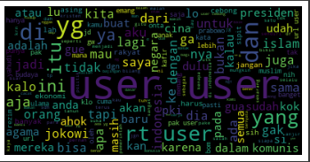
Neutral sentiment refers to a tweet that doesn't express a strong emotion or opinion, either positive or negative. It is a neutral or impartial stance, without showing any particular bias towards or against a particular subject. The tweet is usually descriptive and informative, without any emotional charge or persuasion. Can be seen in the below graph, the majority of words appear are only linking words and words that are not inclined to Positive sentiment or Negative Toxic sentiment.

Slide 13
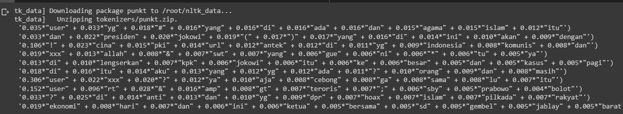
Based on Additional Analysis:
Identifying topics in tweets using topic modeling techniques on the tweet that already cleaned to identify the most frequently discussed topics. The result is:
Politics : presiden, jokowi, komunis, rezim, pki, Prabowo, pilkada
The vulgar words that we censored previously. : xxx
Religion : agama, Islam

Slide 14
03
Result & Conclusion

Slide 15
Result & Conclusion
The analysis of tweets showed that the majority of the tweets are categorized as Neutral sentiment.
The highest average in total words is held by the Positive sentiment.
The majority of the longest words in the "Negative Toxic" sentiment appear around 5 to less than 10 words, for “Positive" sentiment the majority appears around 5 to 10 words and for “Neutral” sentiment appear around 5 to less than 15 words.
The words "xxx", which were used for censoring vulgar words during data cleaning, often appear in the "Negative Toxic" sentiment.
The additional analysis using topic modeling techniques revealed that the most frequently discussed topics in the tweets are politics, religion, and vulgar words that were censored previously (“xxx”).

Slide 16
Evaluating the effectiveness of censorship techniques can help in analyzing and monitoring the occurrence of hate speech in social media. This can provide insights on the efficiency of the censorship techniques in removing hate speech and highlight areas for improvement. By understanding the factors that contribute to the presence of hate speech, businesses and social media platforms can take steps to reduce its occurrence and create a safer online environment for users.

Slide 17
Thank You

